Slide 1
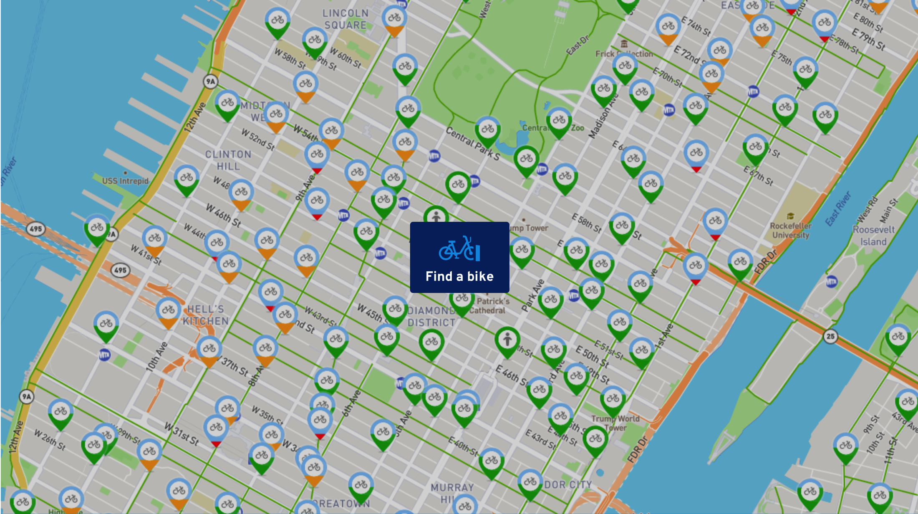
Citibike 2017 Data Analytics Simon Alizadeh

Slide 2
Data Sources & Cleanup
Data Source: https://s3.amazonaws.com/tripdata/index.html
Data Original Format: 12 csv files covering 12 months of 2017
Data Cleanup tool: Python (jupyter notebook)
Data Cleanup Steps:
Populated blank Birth Years with overall average Birth Year
Populated blank Gender fields with average Gender type proportional to males and female populations
Added Season column for Seasonal Trend Analysis

Slide 3
Story Points
Top 20 Stations by Location
Age and Gender Analytics
Seasonal Trends
Ridership Growth Analysis

Slide 4
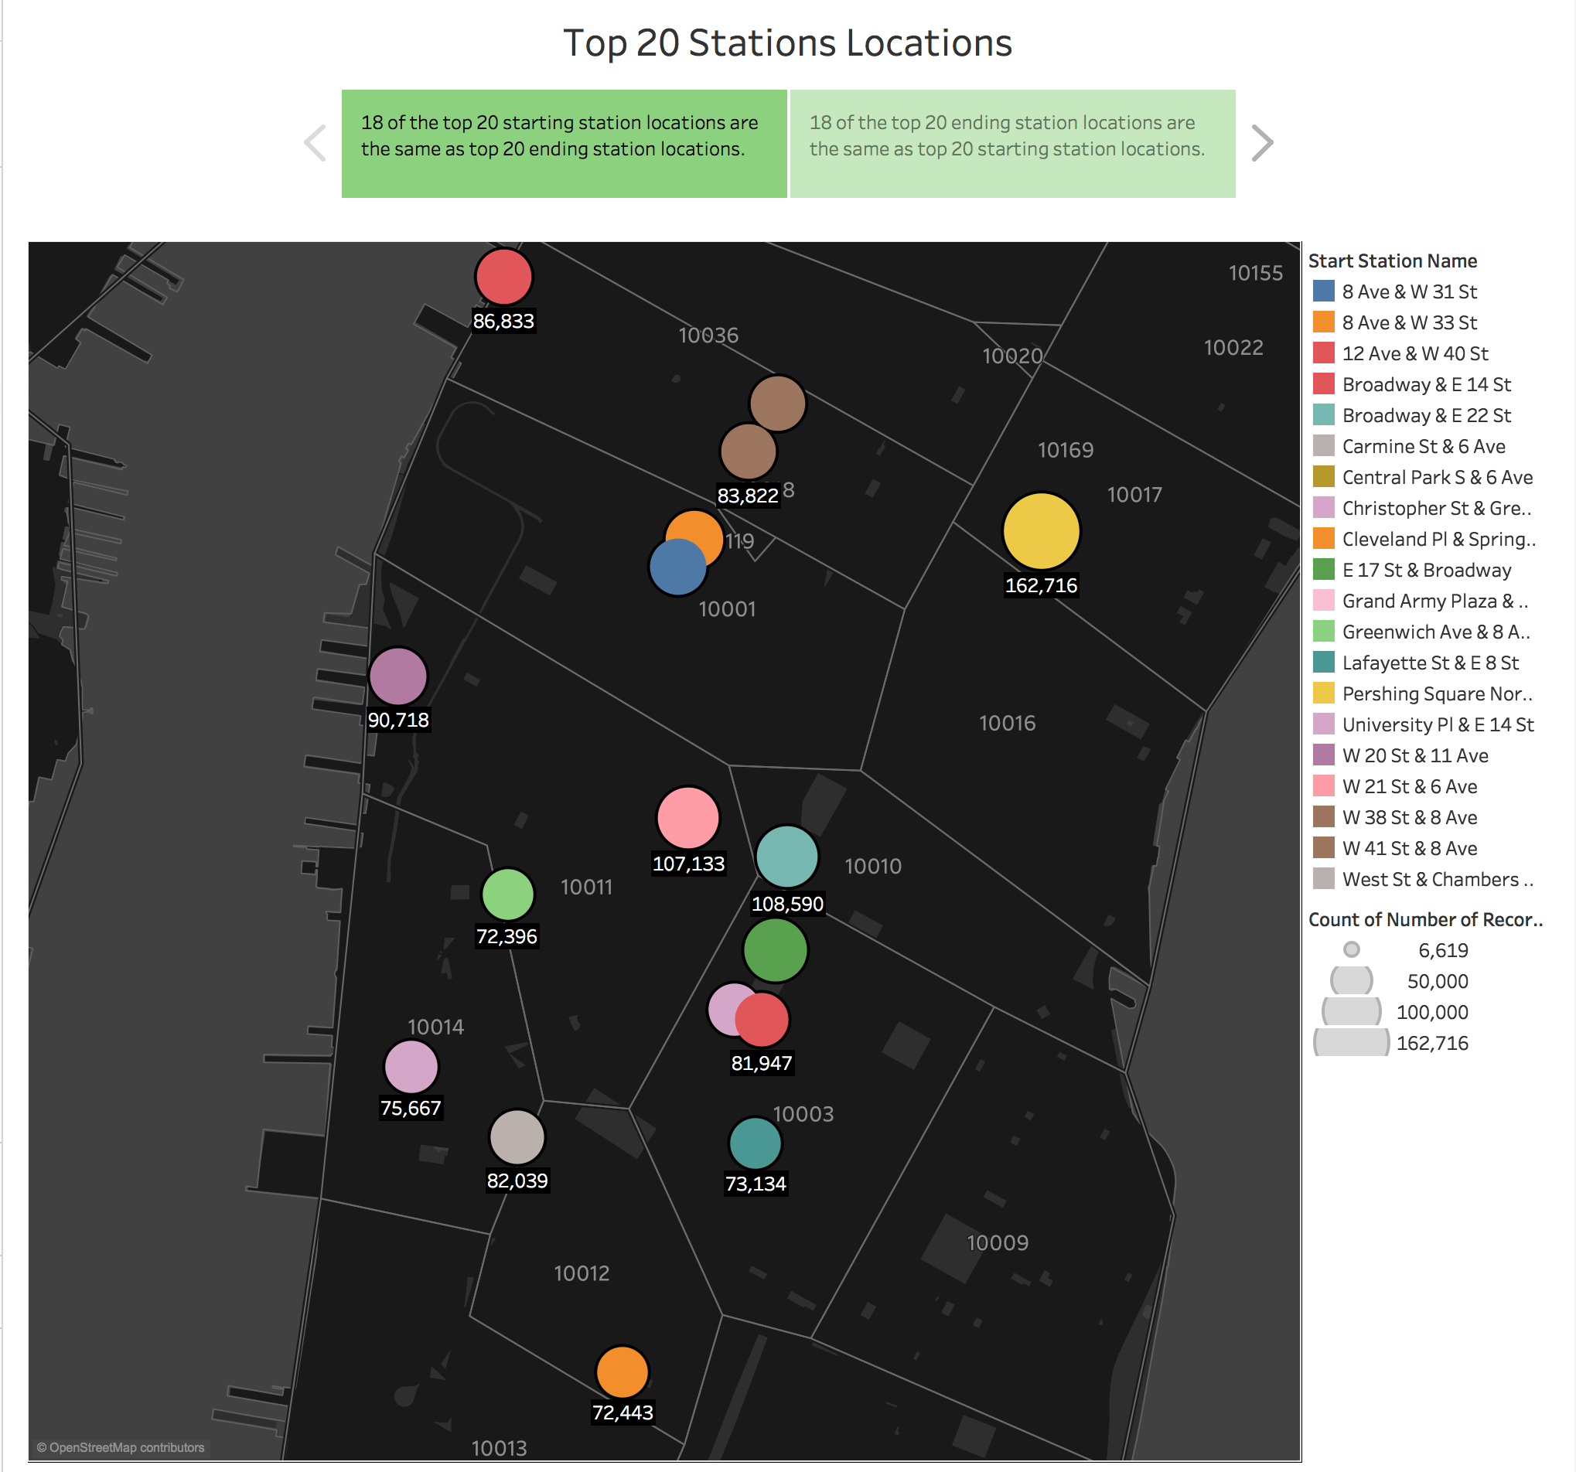

Slide 5
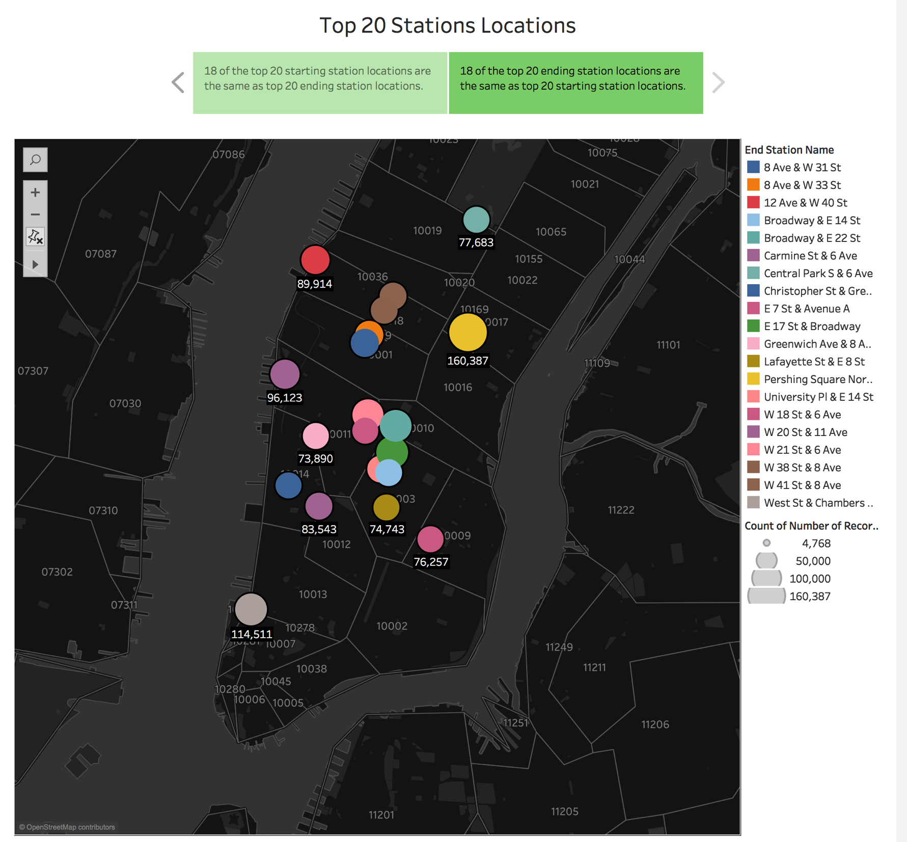
SDSD

Slide 6
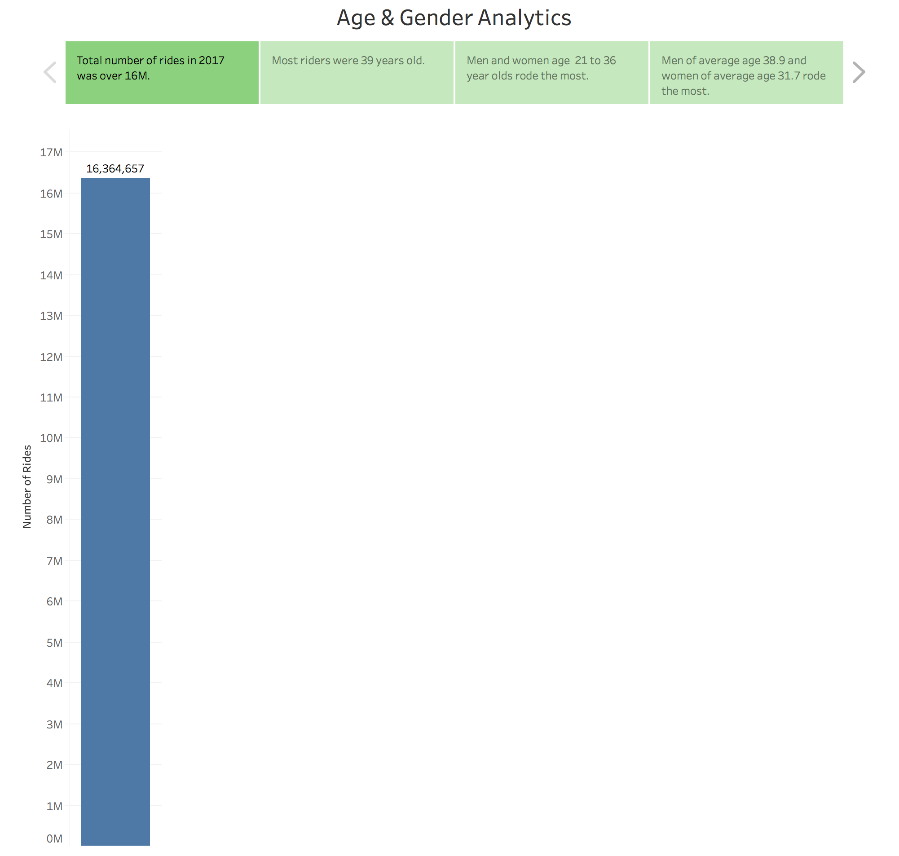

Slide 7
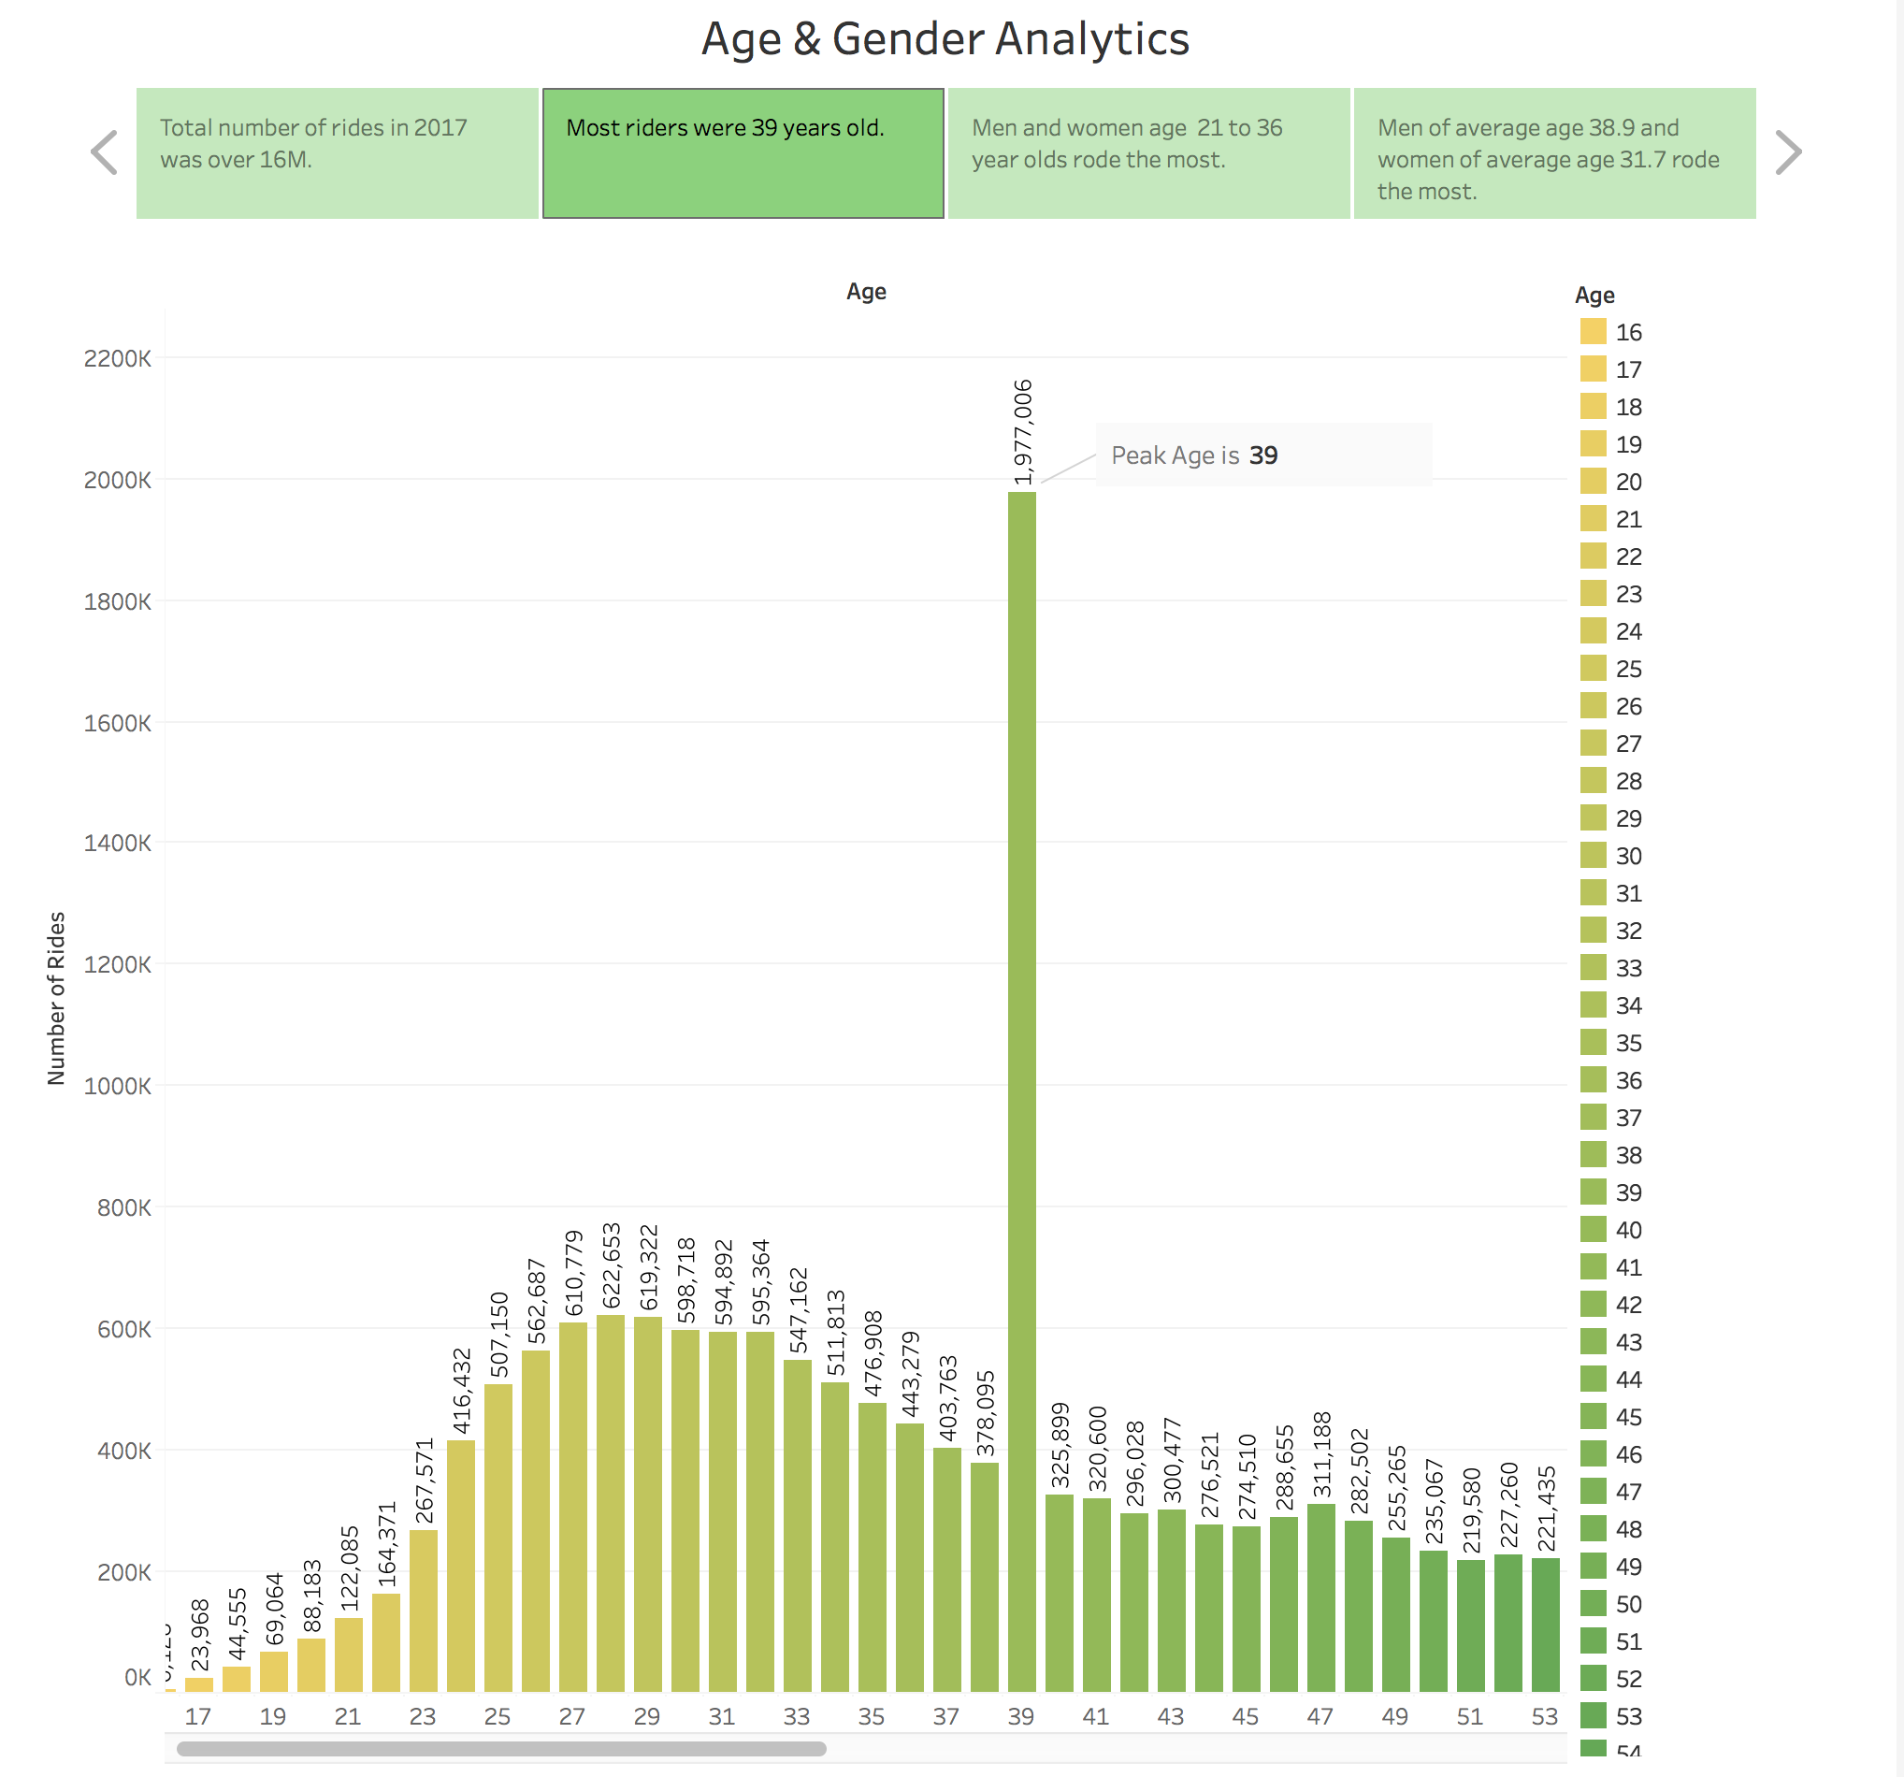

Slide 8
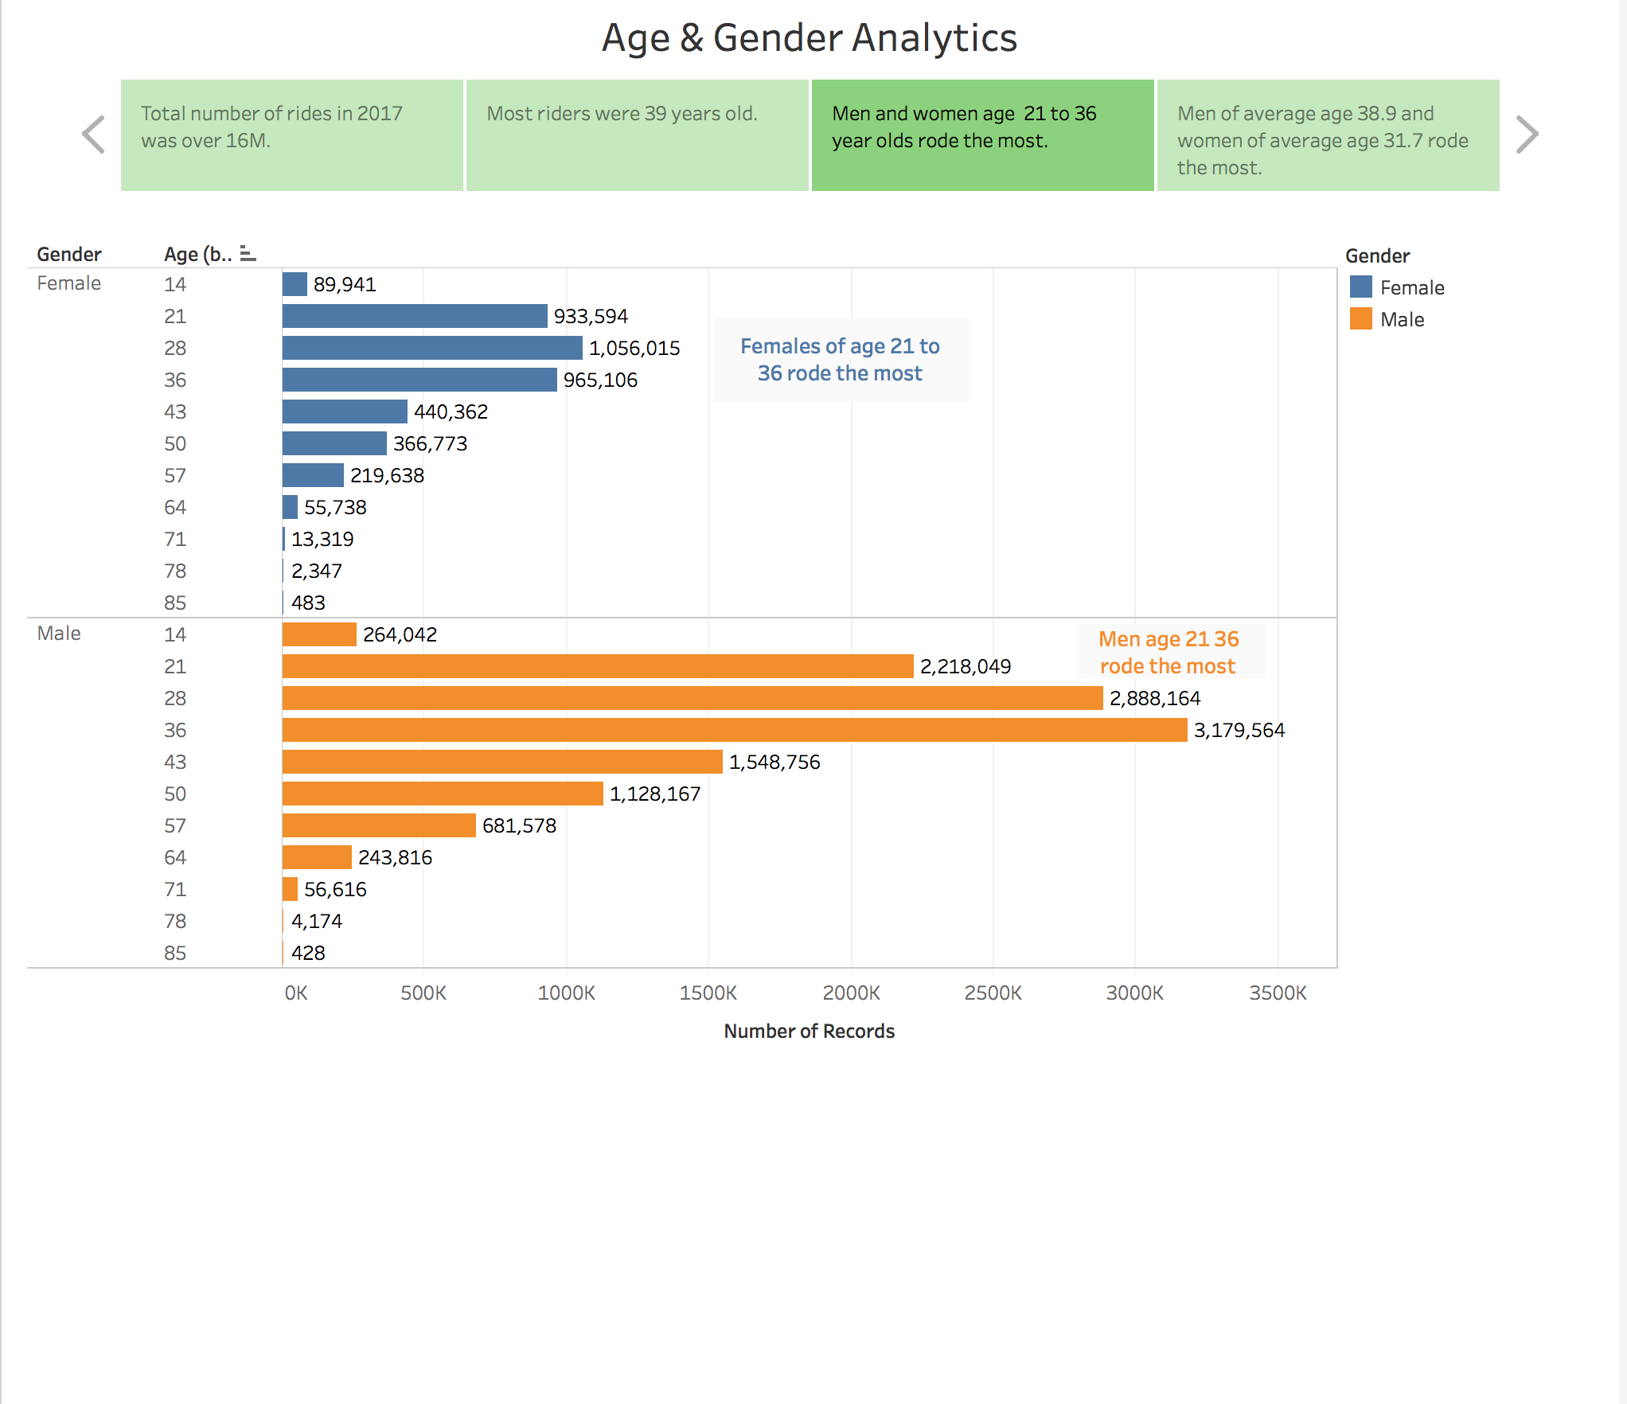

Slide 9
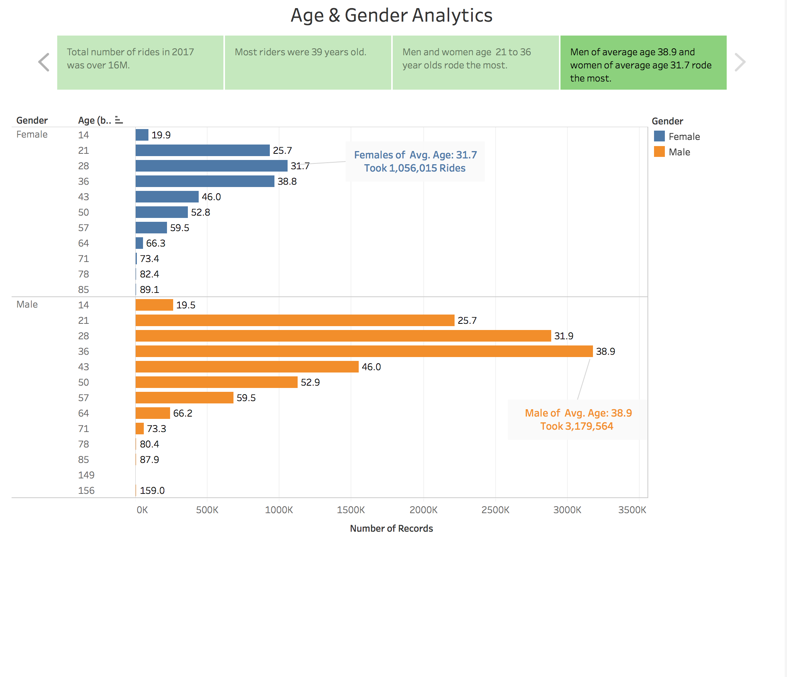

Slide 10
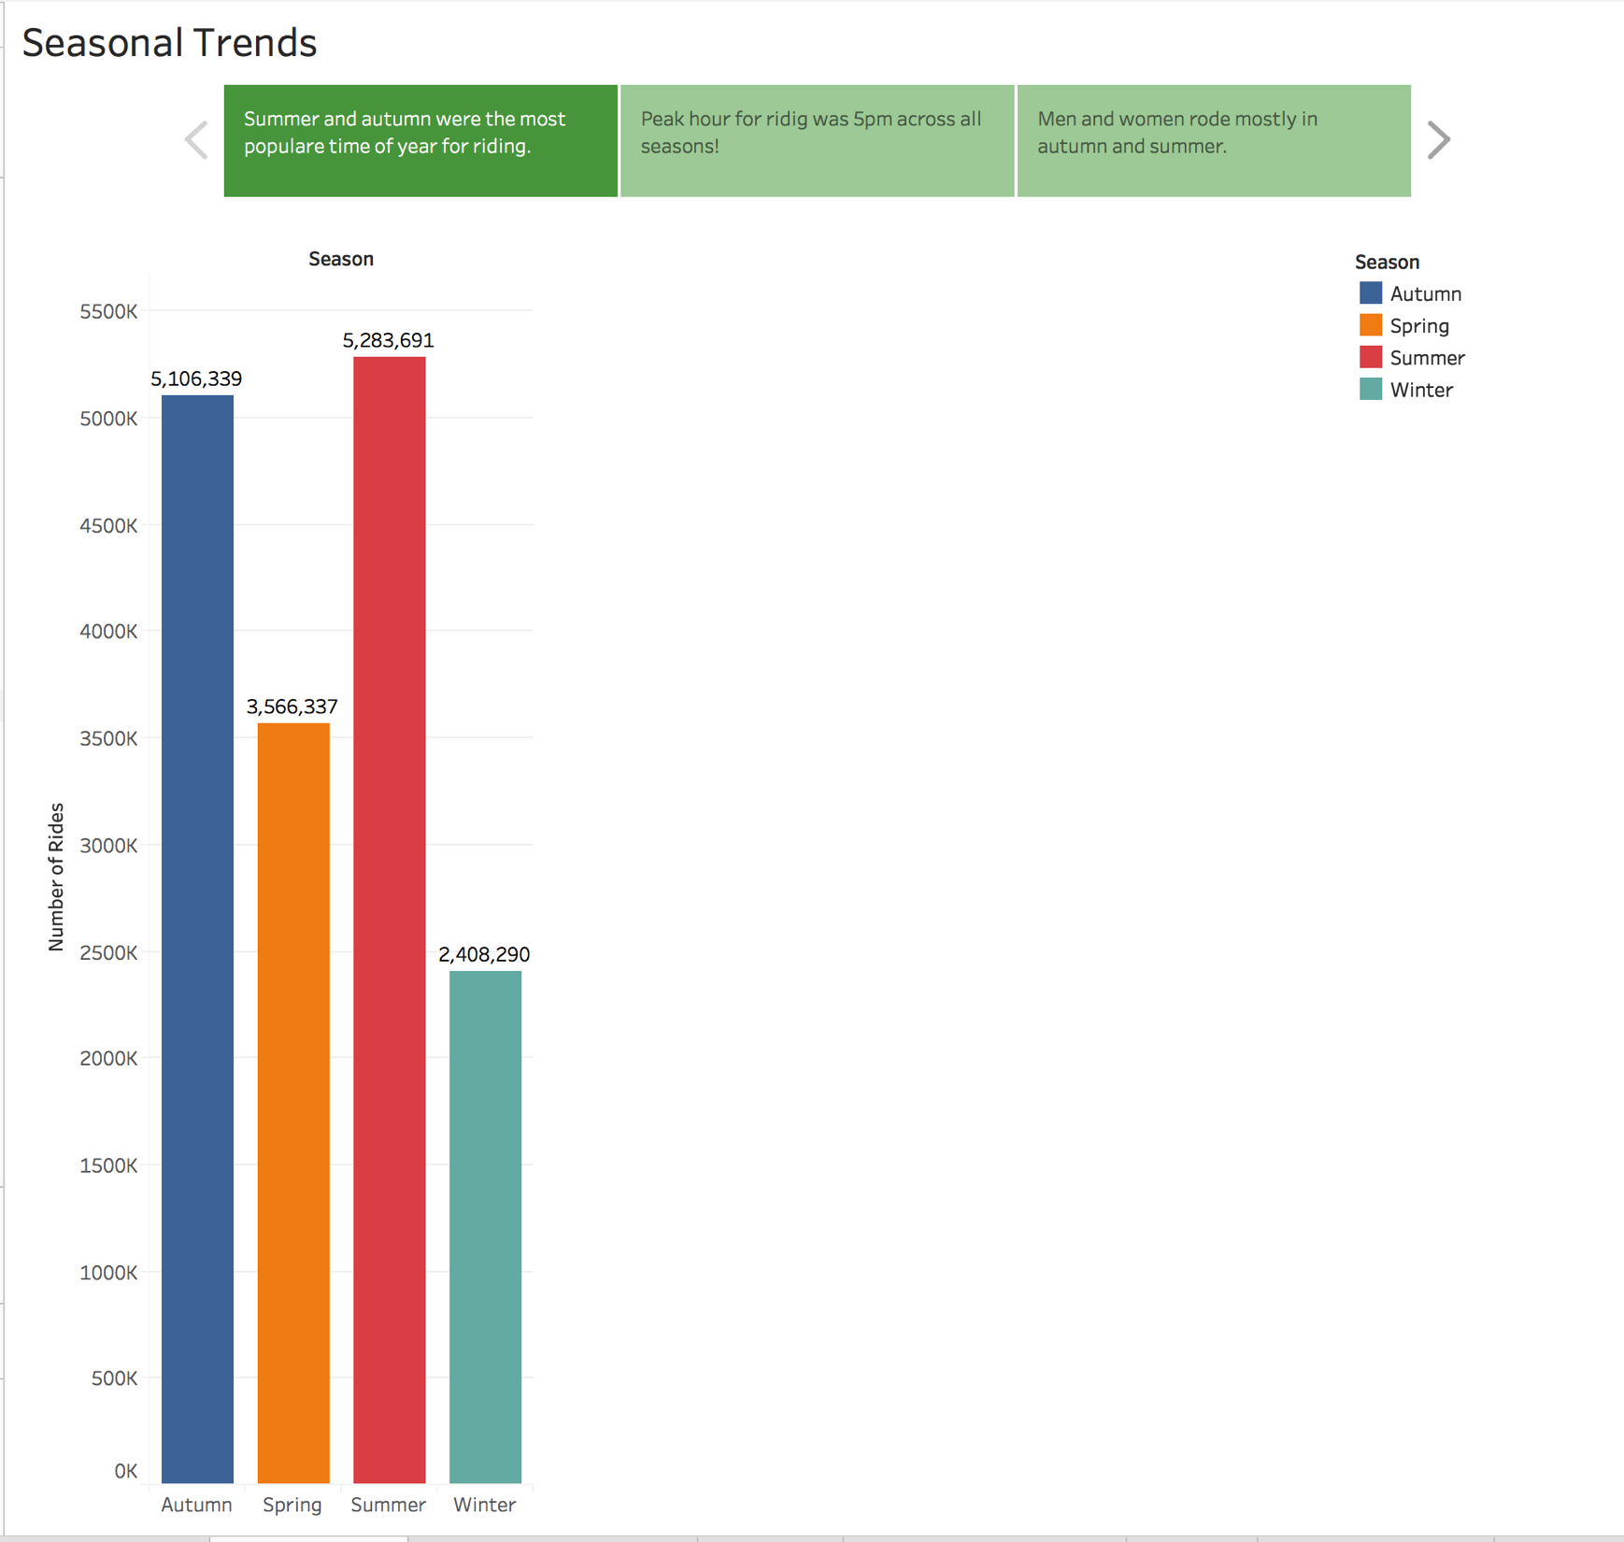

Slide 11
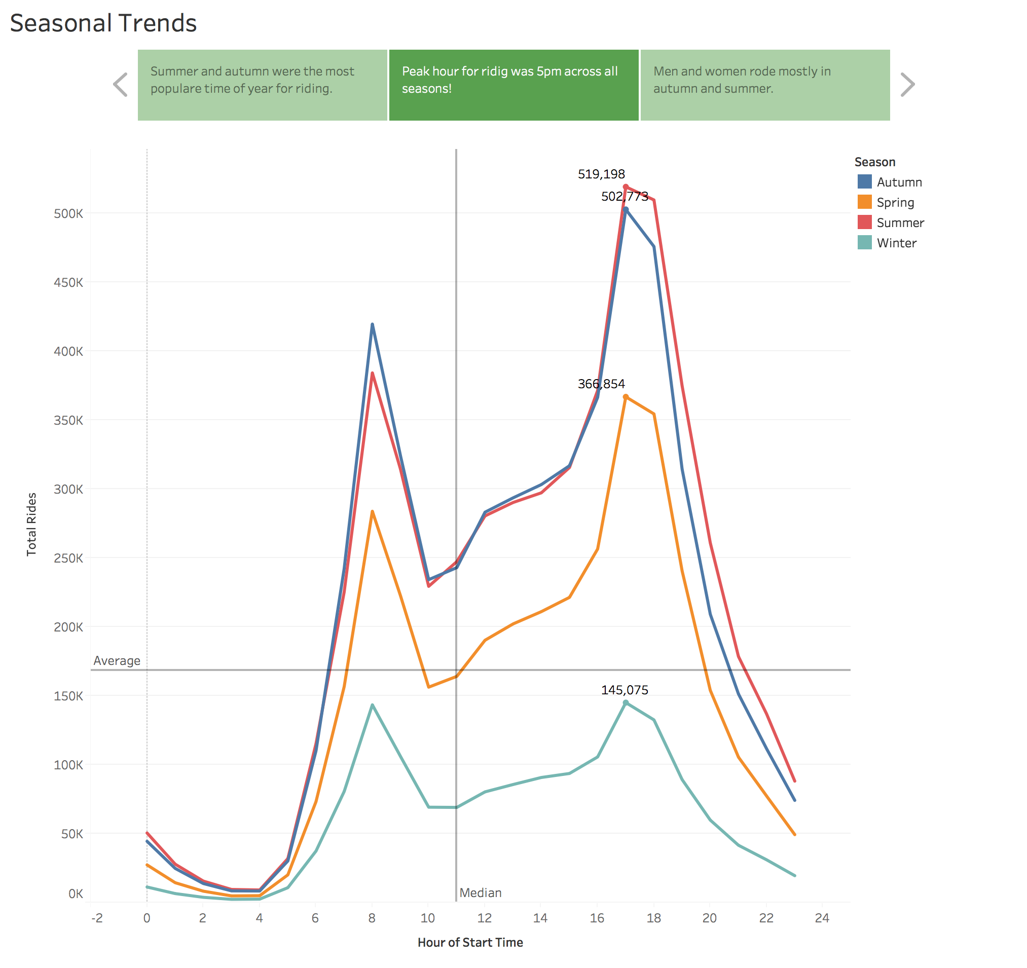

Slide 12
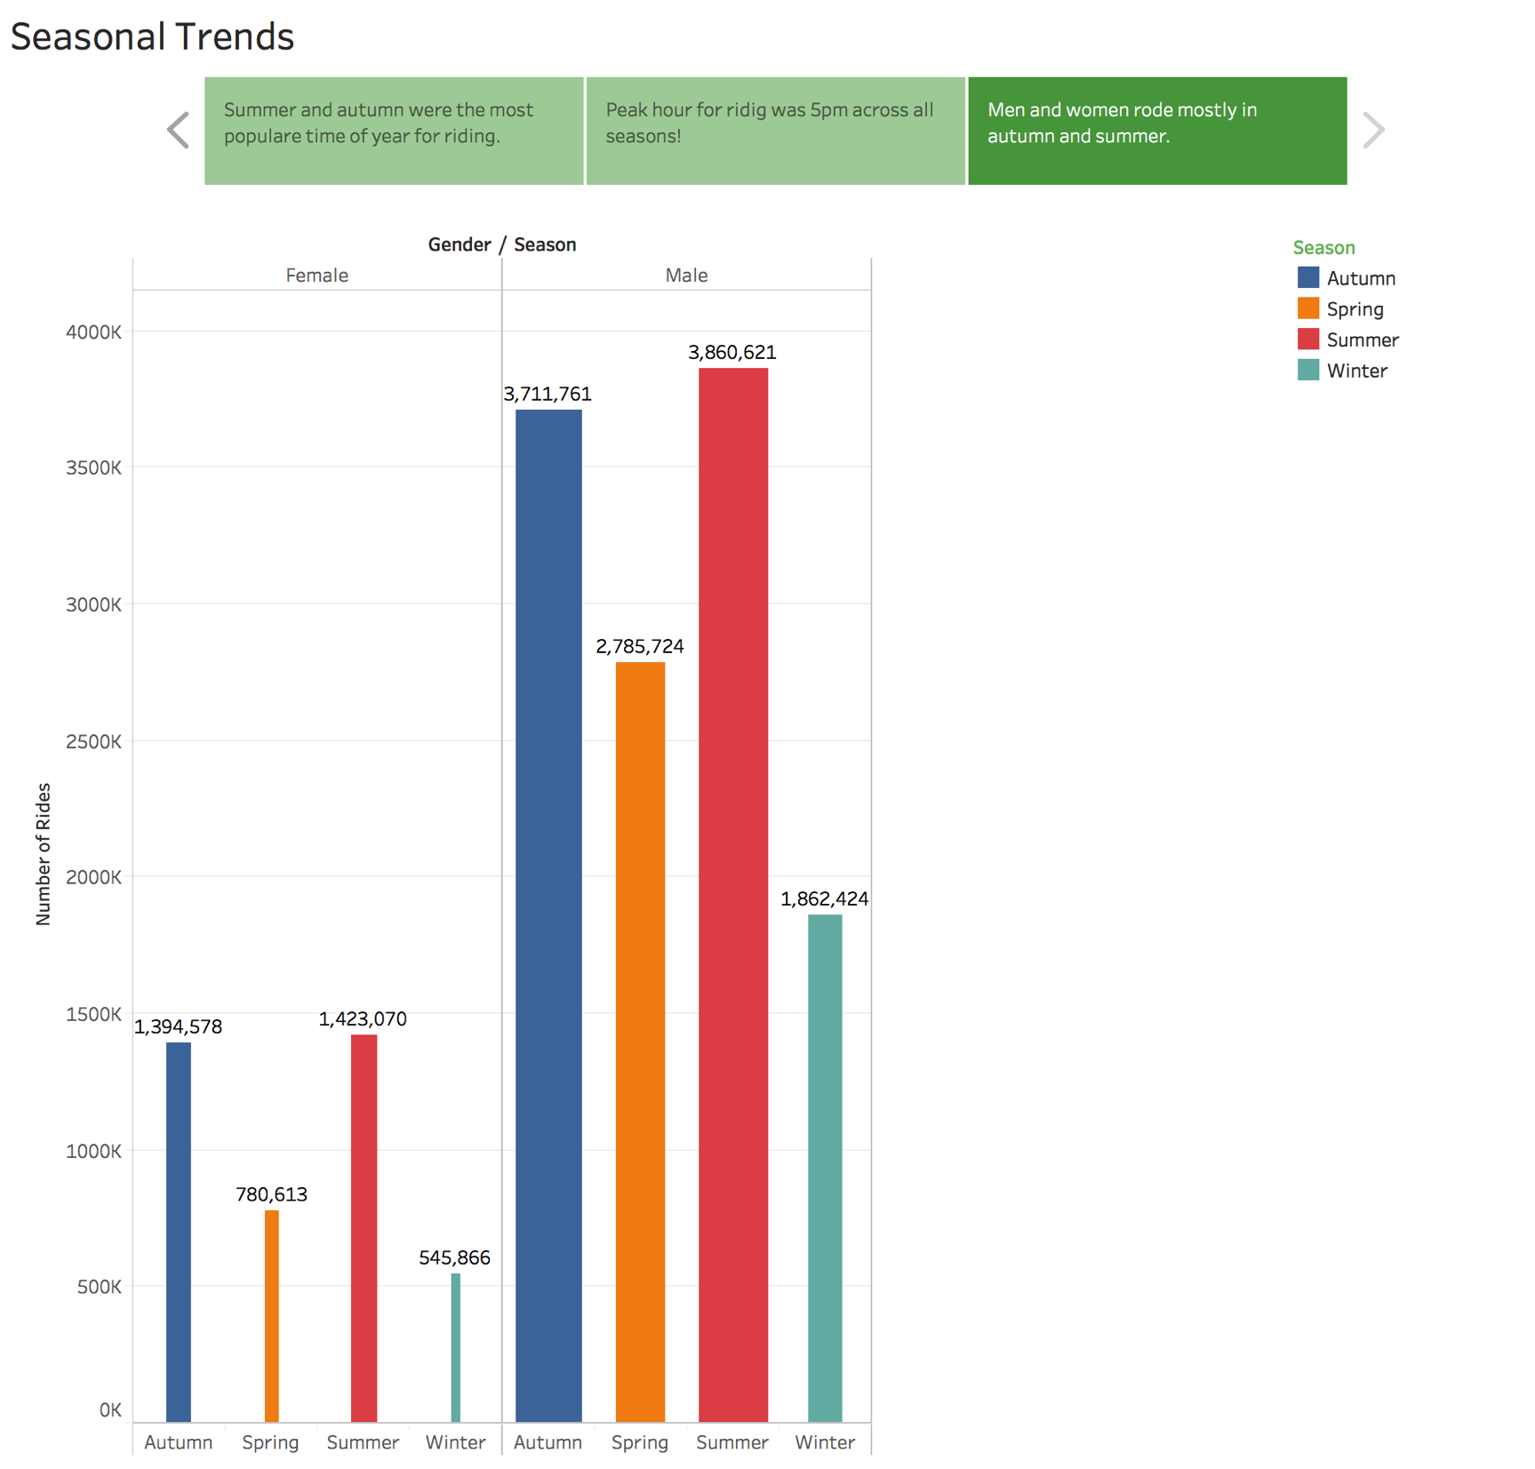

Slide 13
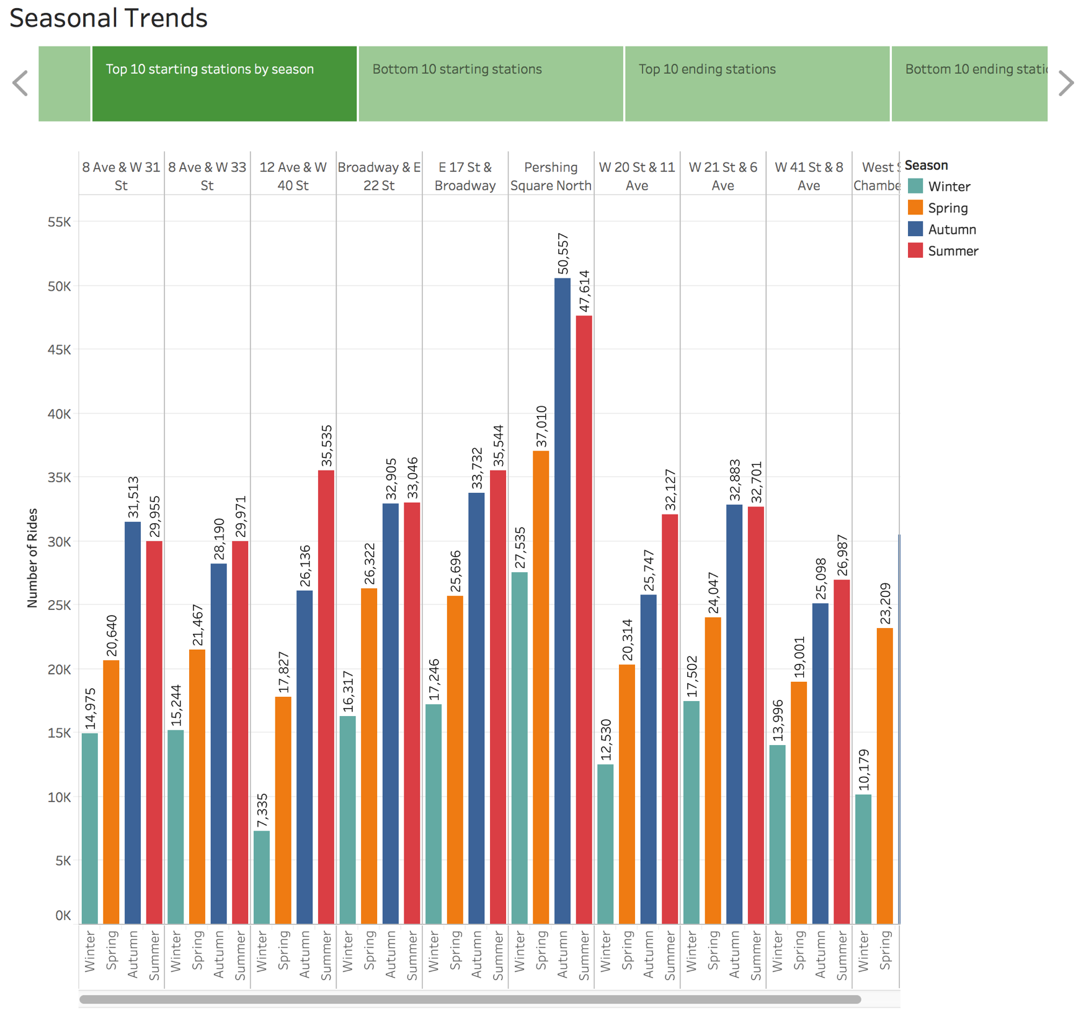

Slide 14
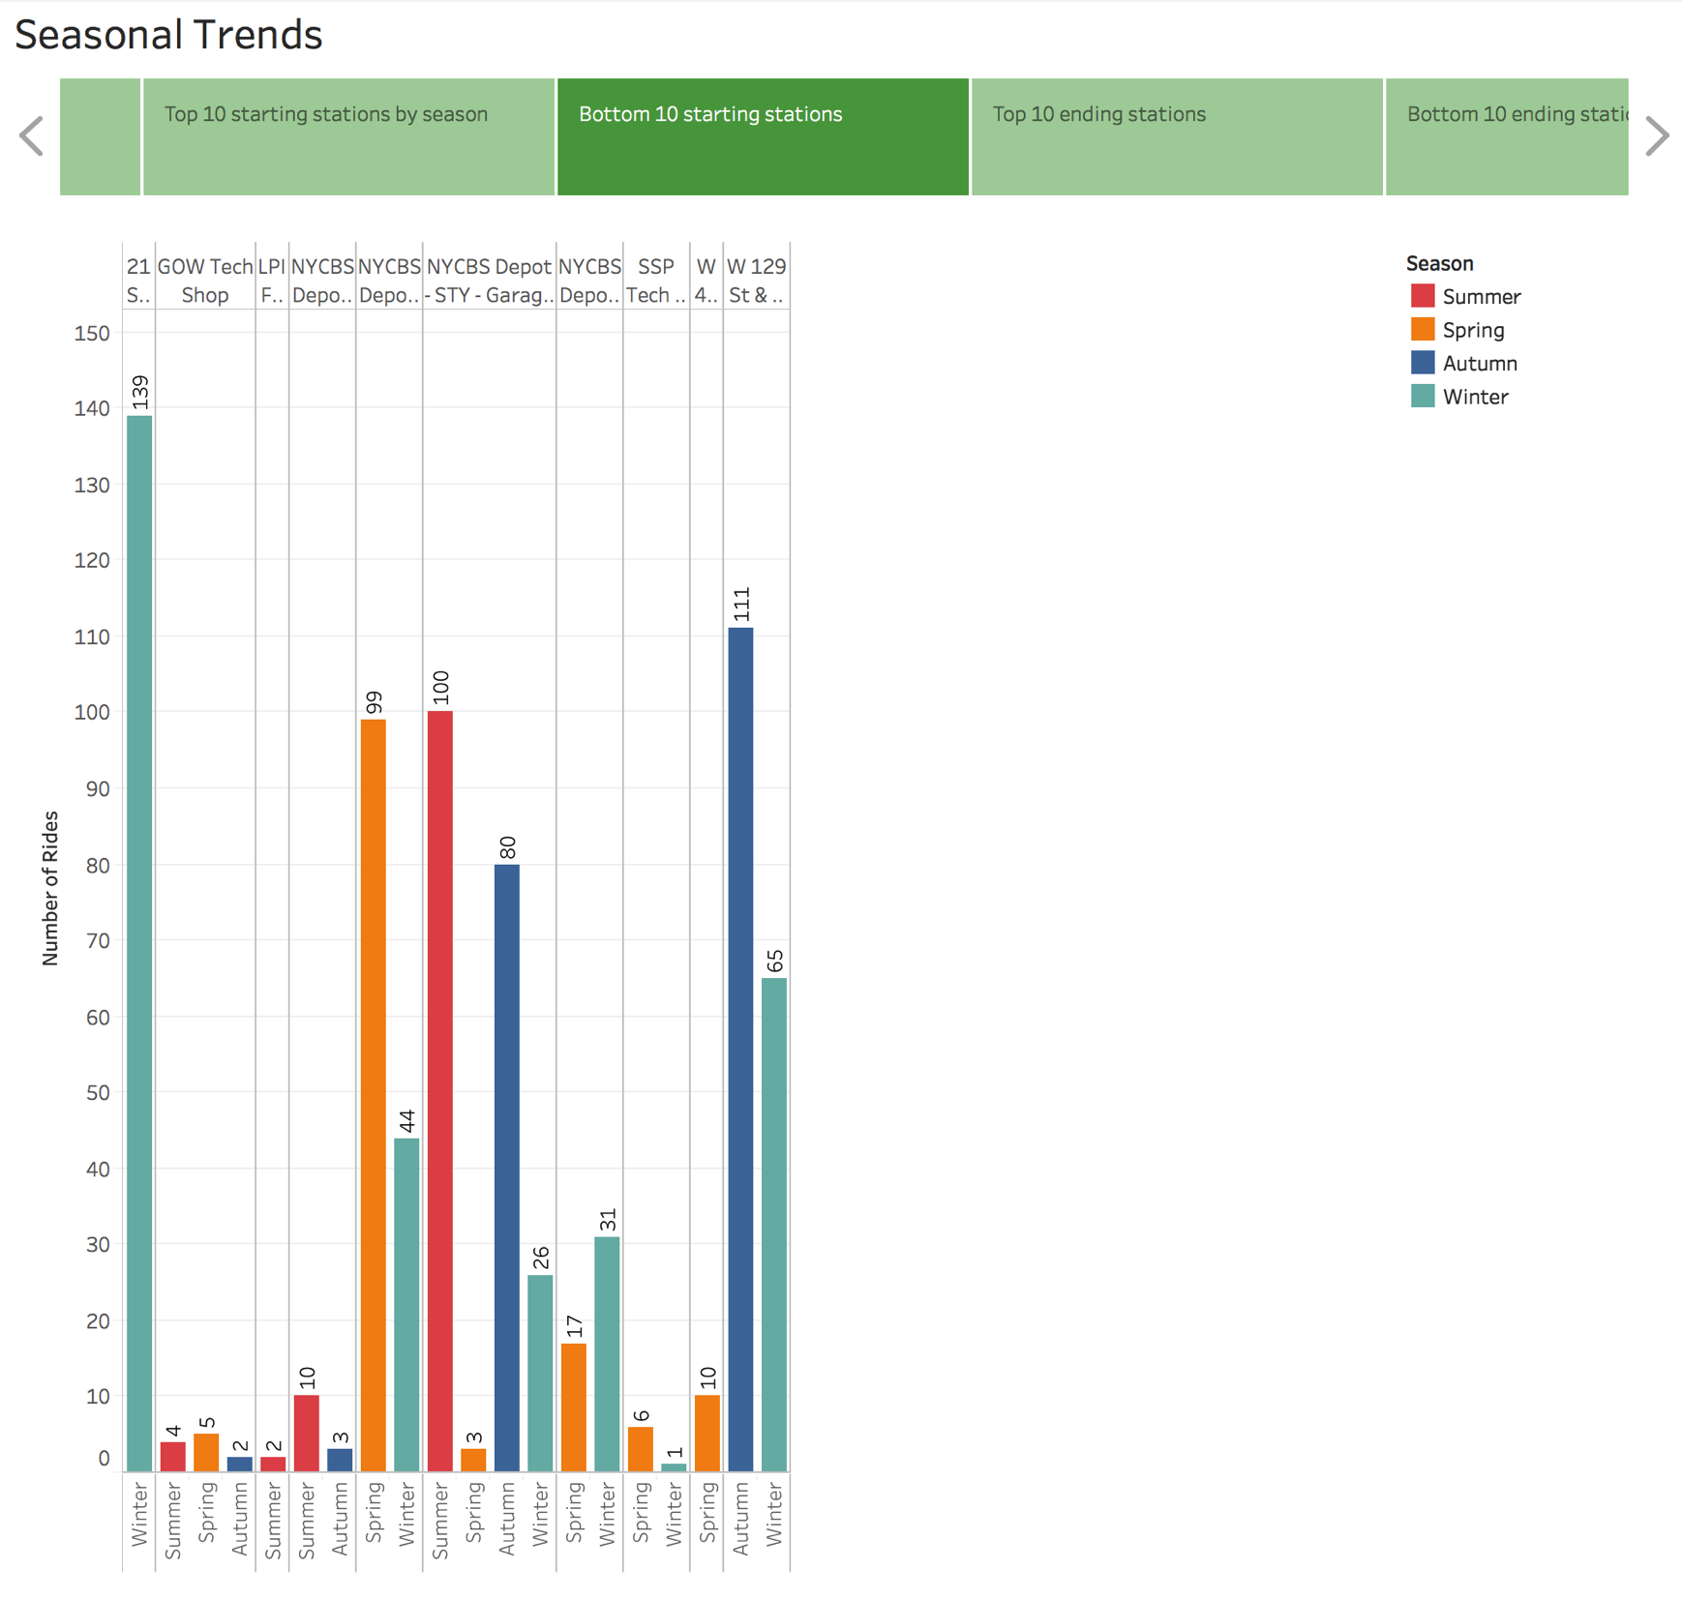

Slide 15
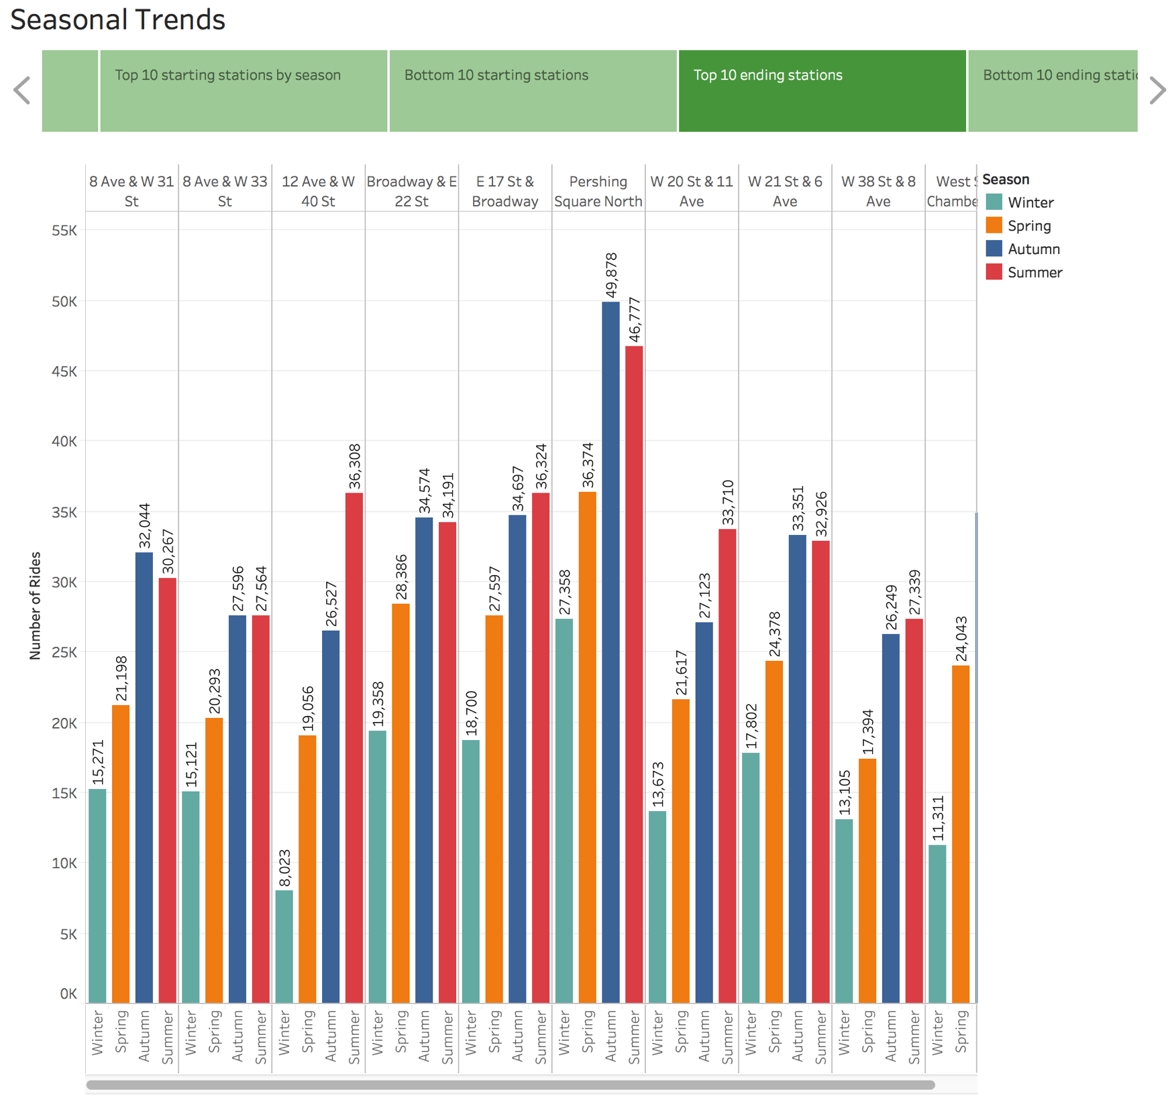

Slide 16
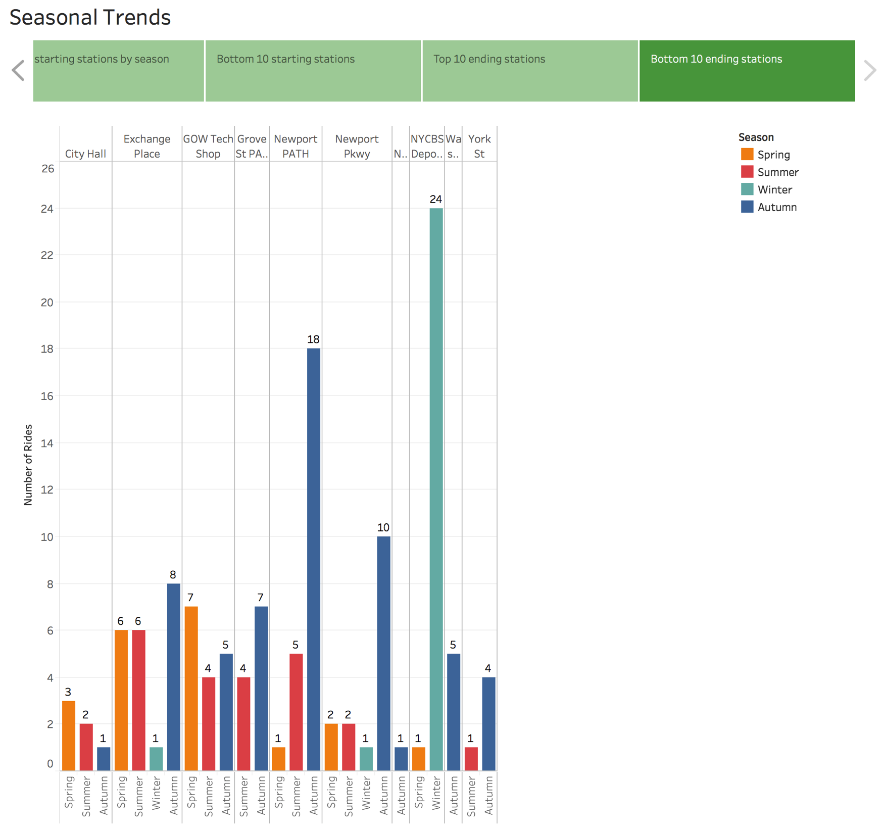

Slide 17
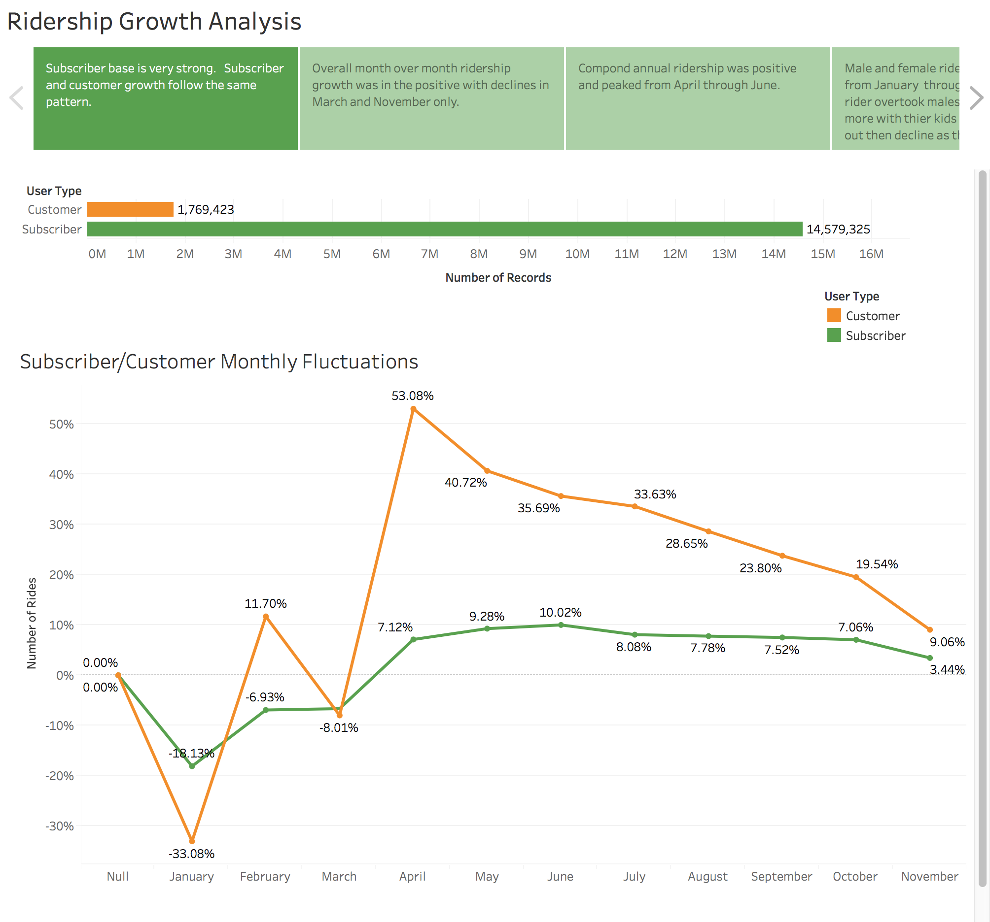

Slide 18
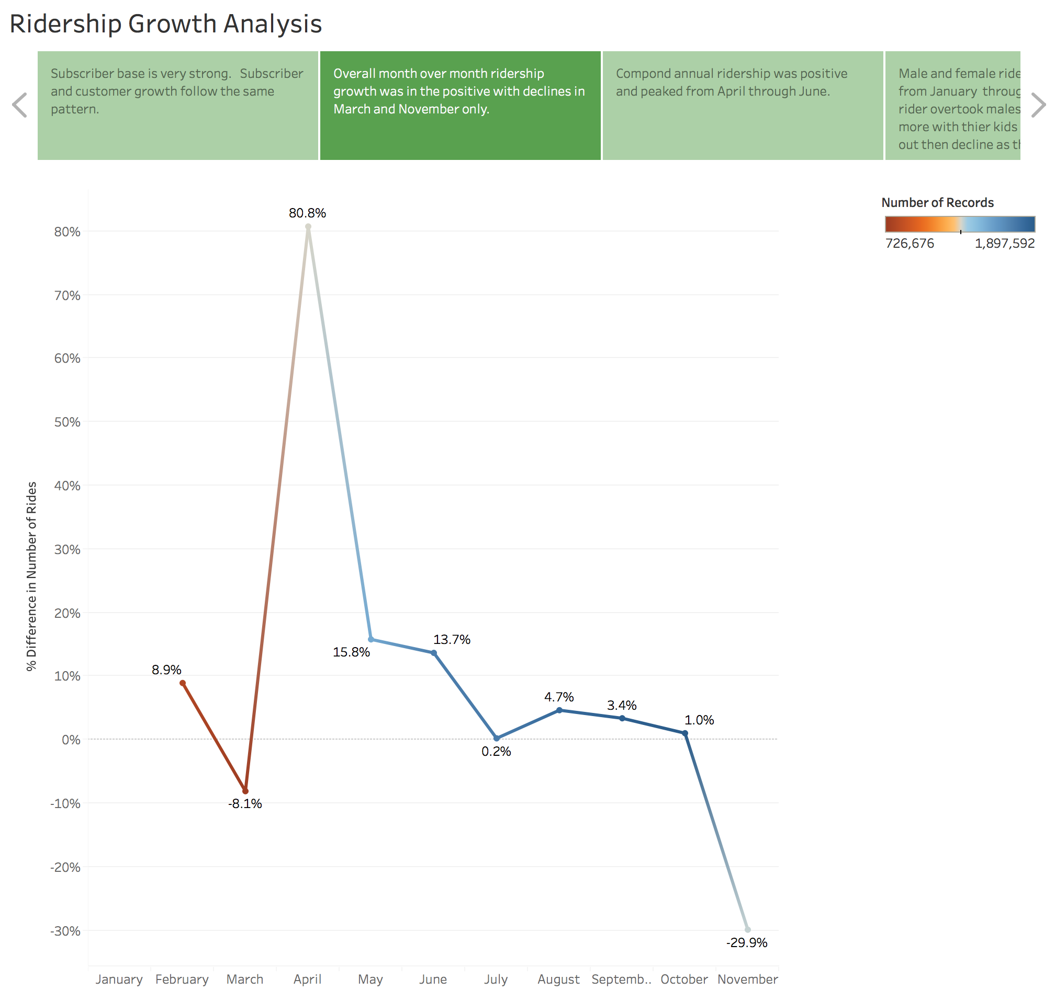

Slide 19
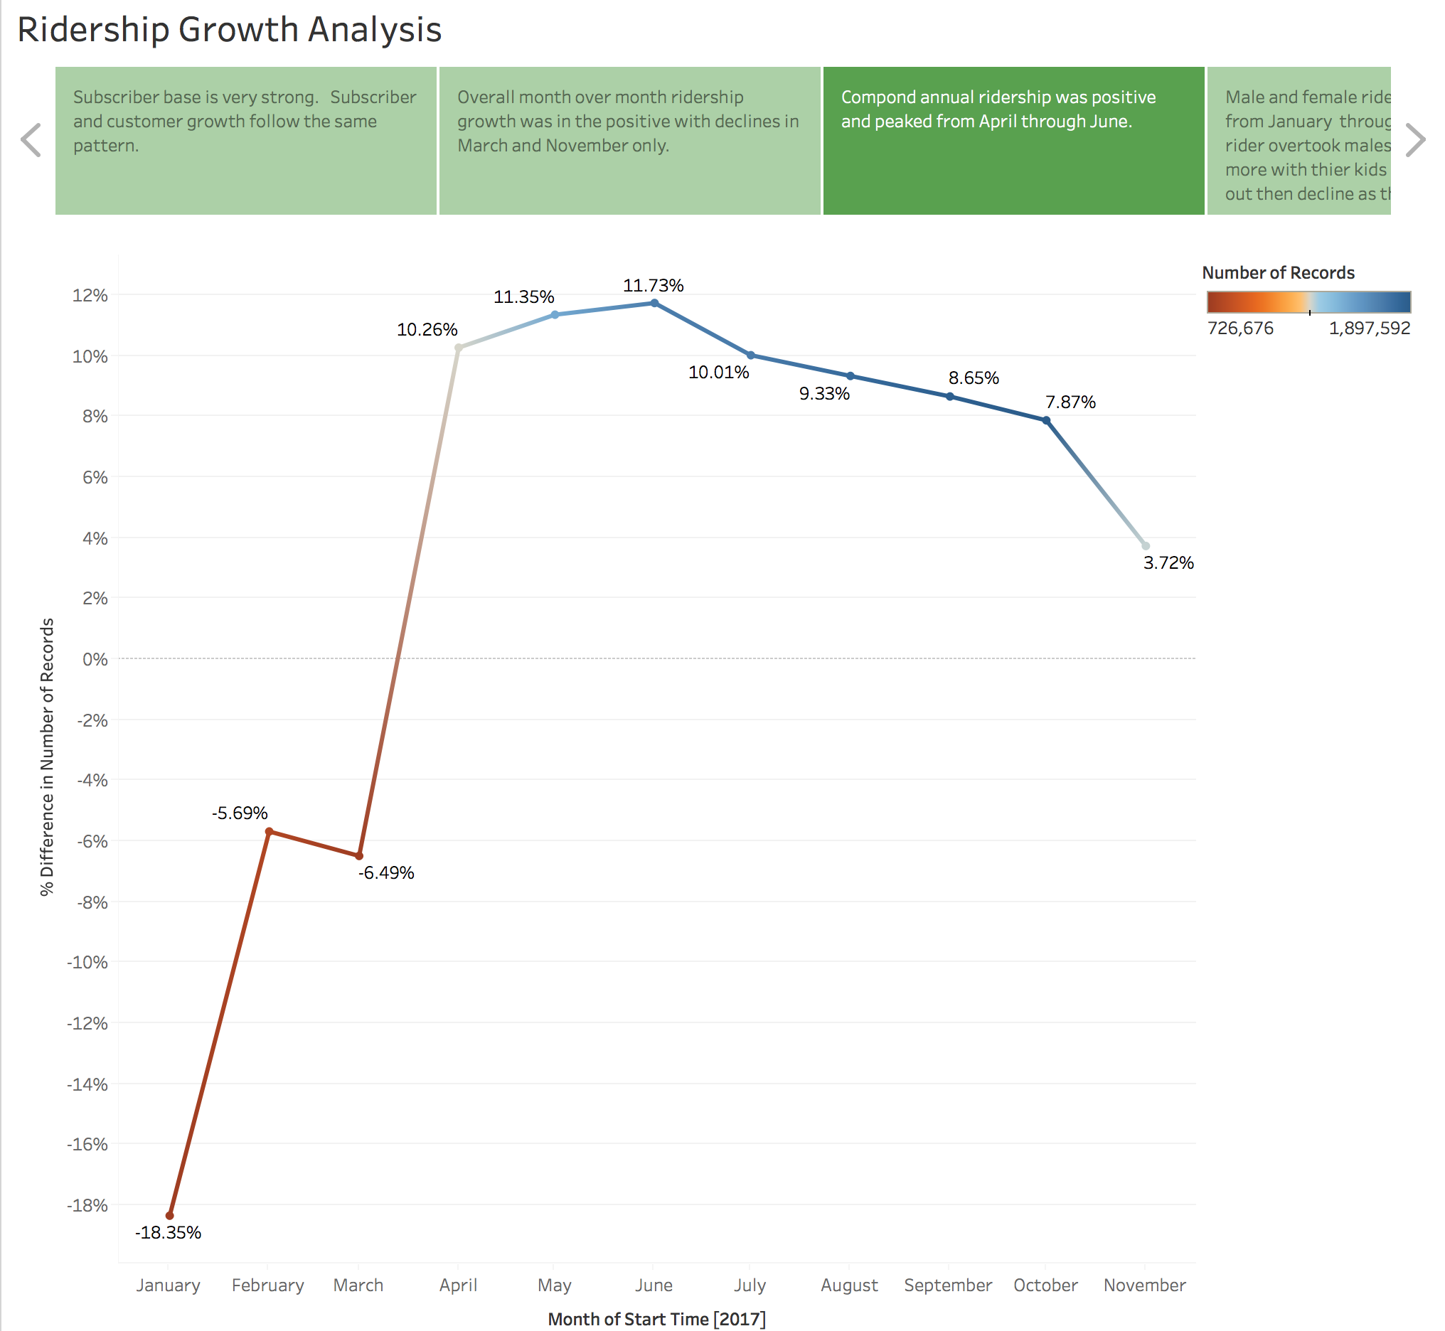

Slide 20
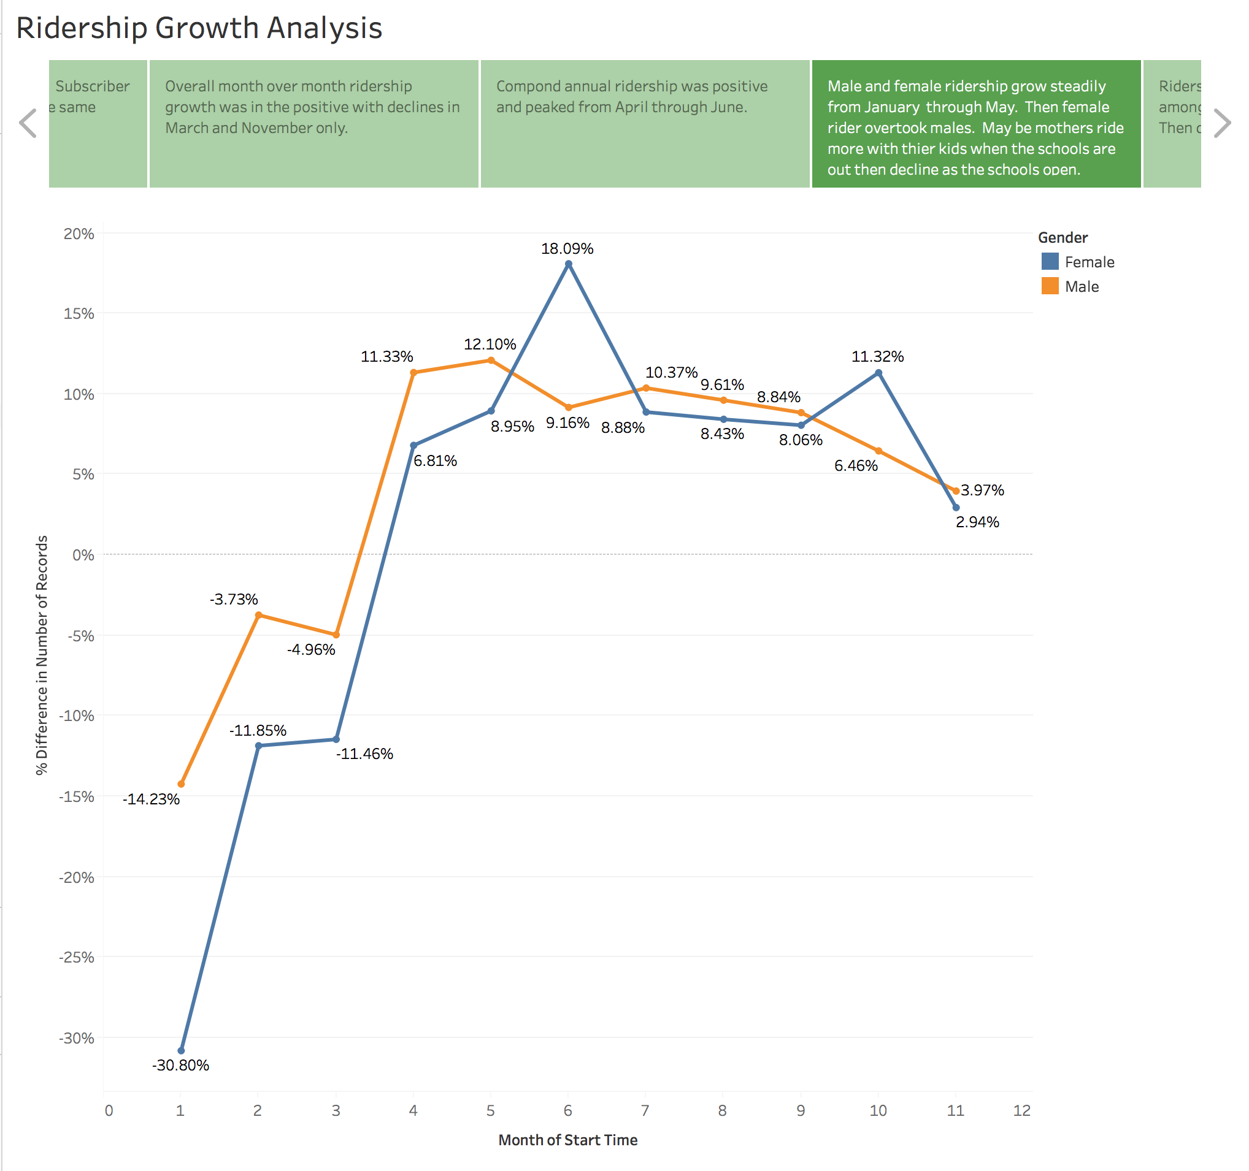

Slide 21
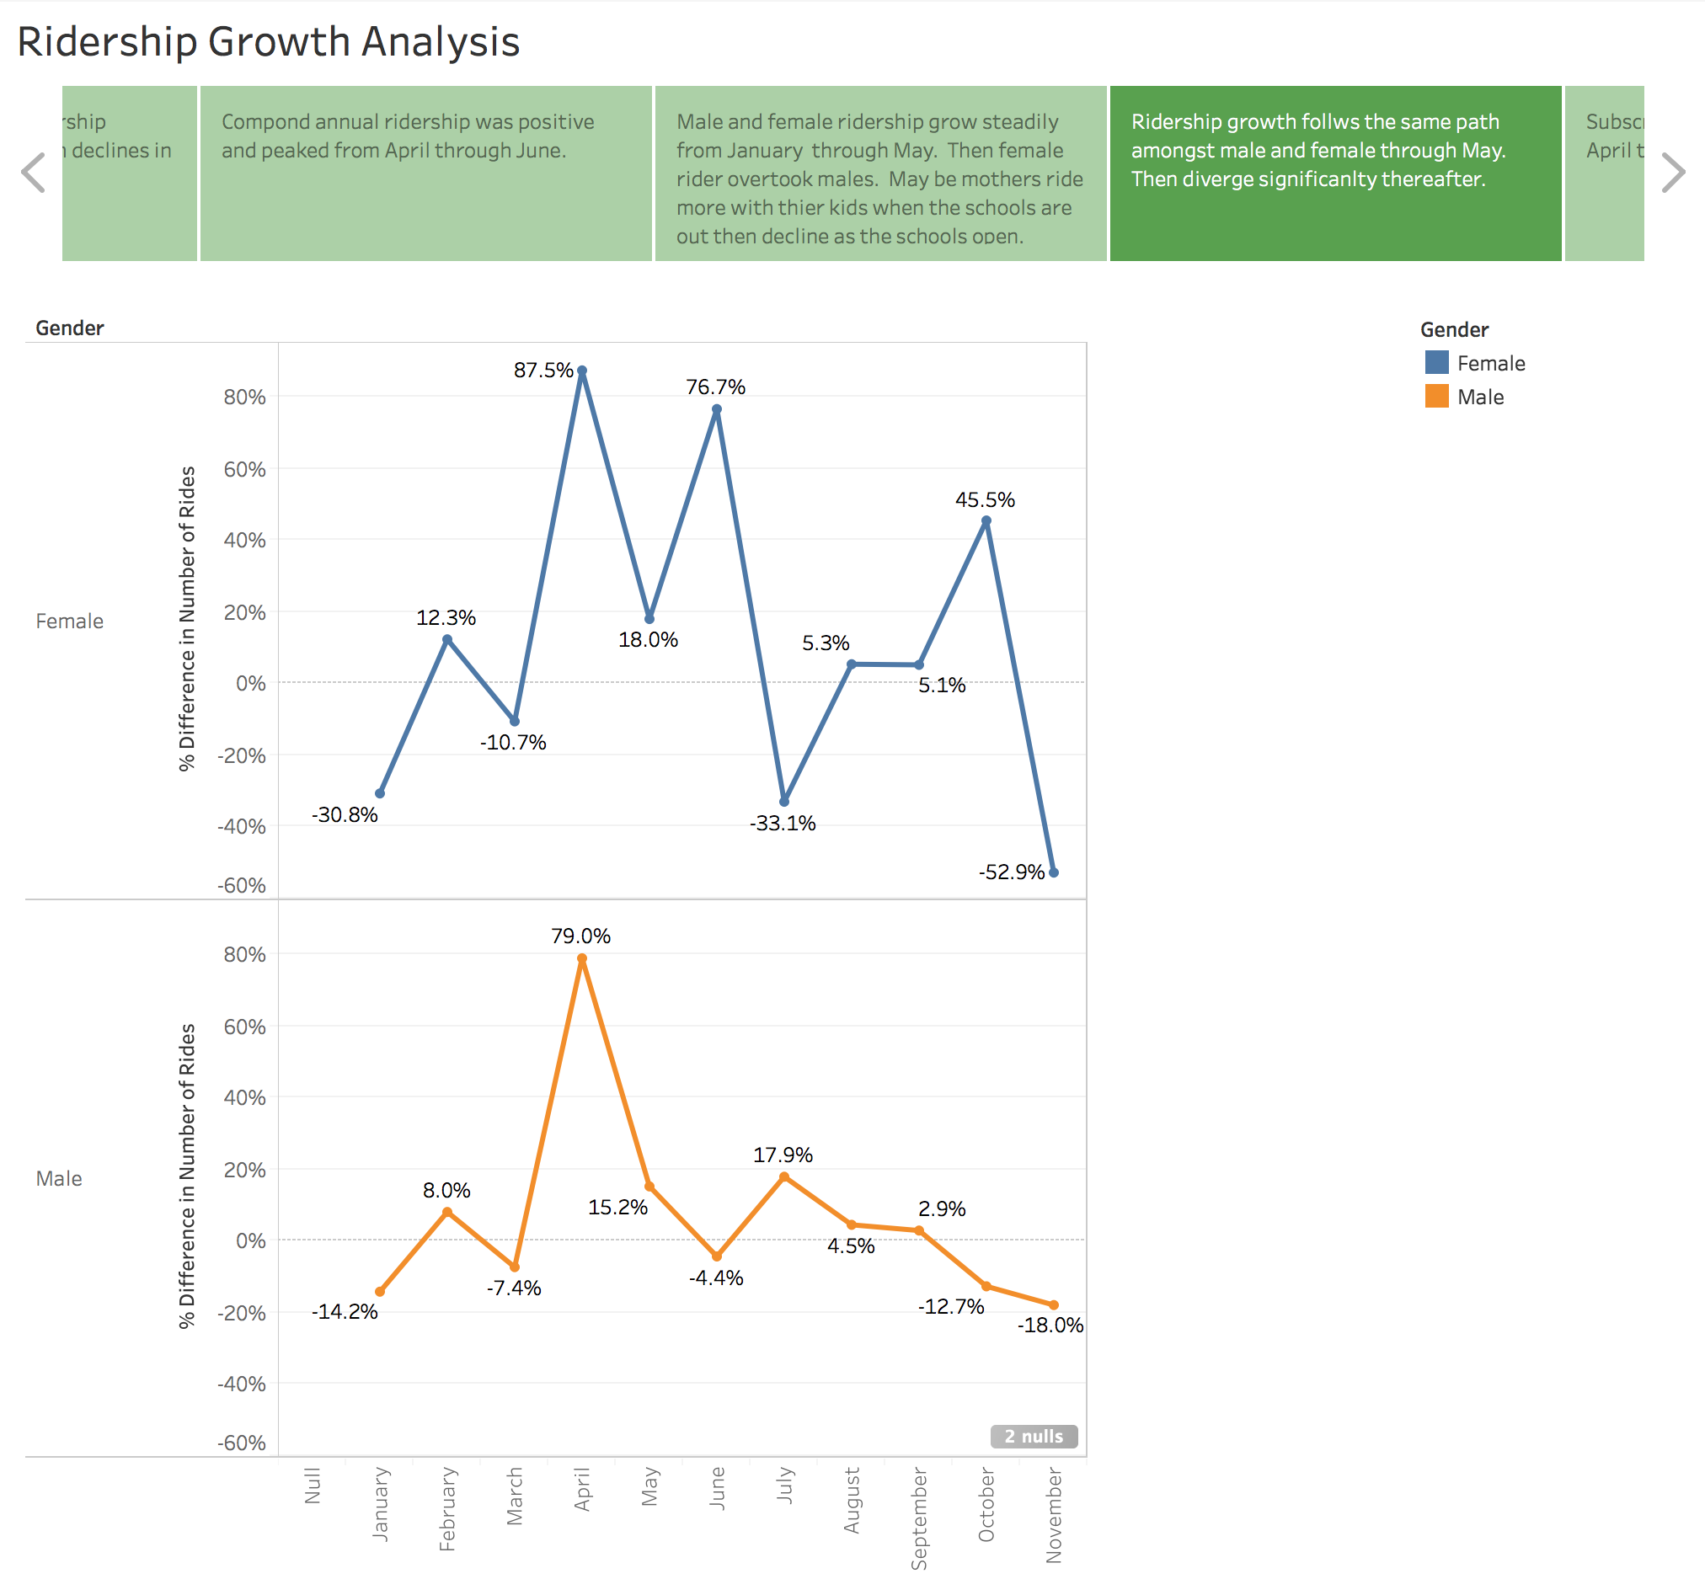

Slide 22
